Slide 1
Chapter No 12
BEE-12 A, B & C
Dec-2022

Slide 2
General Information on op-amp 741
Introduction

Slide 3
Chapter No 12 sub-sections
MOSFET Operational amplifier
BJT 741 Operational amplifier
Identifying subsection of 741
DC /Biasing analysis
Small signal analysis
Modern techniques for design of BJT Operational amplifier

Slide 4
Introduction
The 741 Op Amp IC is most commonly used general purpose Operational Amplifier.
It was first manufactured by Fairchild semiconductors in the year 1963.
It performs both mathematical operations and amplification functions (mathematical operations like addition, subtraction, multiplication, division, differentiation, integration, etc.)

Slide 9
8 Pin DIP Package 2. TO5-8 Metal can package 3. 8 Pin SOIC

Slide 10
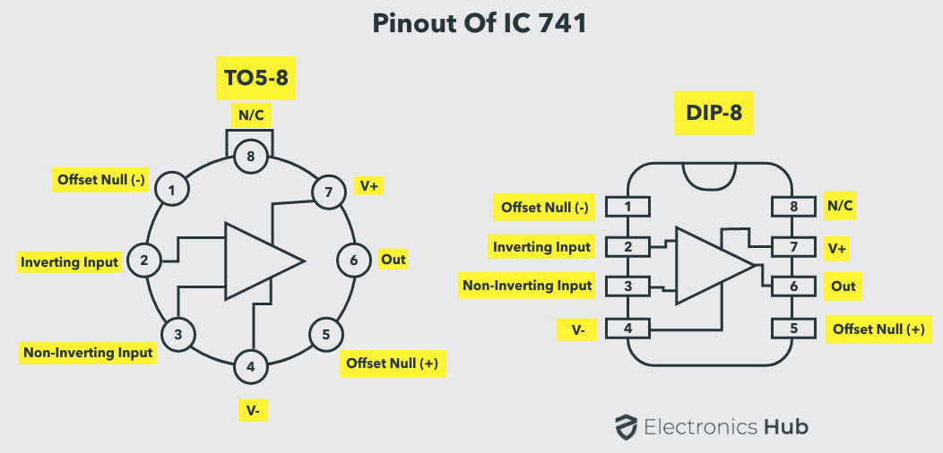

Slide 13
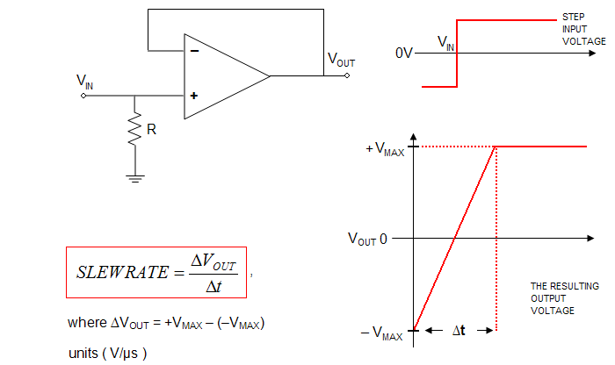

Slide 14
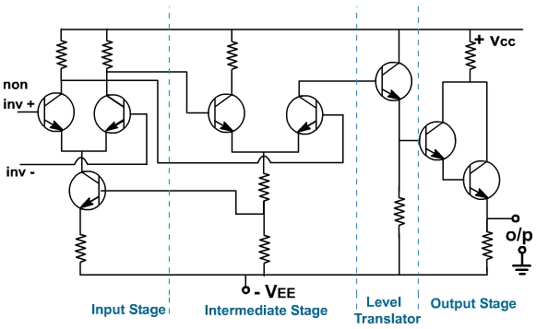
Conceptual Circuit Diagram of BJT Op-amp

Slide 15
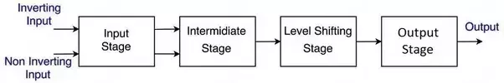
The input stage is a dual point, balanced output differential amplifier. This stage generally provides most of voltage gain of amplifier and also establishes the input resistance of op-amp. The intermediate stage is usually another differential amplifier , which is driven by output of first stage . In most amplifiers, the intermediate stage is dual input, unbalanced(single-ended) output. Because direct coupling is used, the DC voltage at the output of intermediate stage is well above ground potential. Therefore , generally a level translator(shifting) circuit(usually Emitter Follower) is used after intermediate stage to shift the DC level to zero volts with respect to ground.

Slide 16
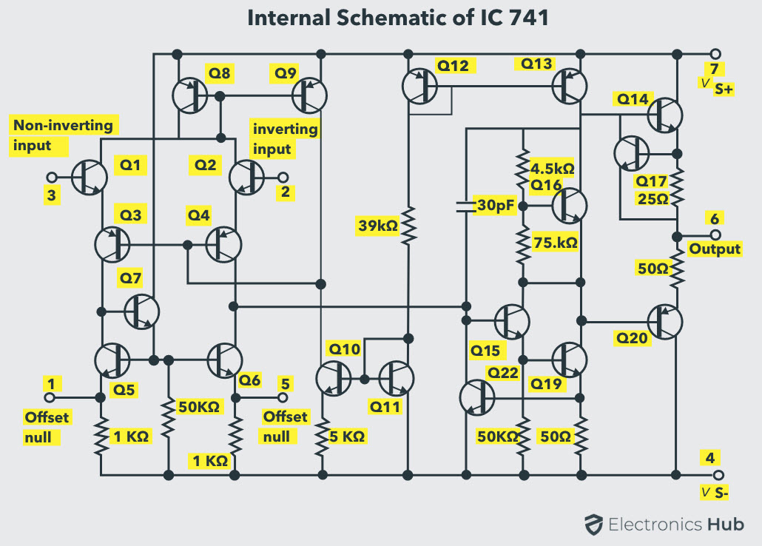

Slide 18
Part-I Recognizing / Identifying various sub-sections of 741

Slide 19
$V_{BE}$ for $Q_{14} and Q_{20}$
Current Mirror
Current Mirror
Reference
DC Biasing /Current Mirror
Widlar Current Mirror

Slide 21
Input Stage

Slide 22
Input stage
Base current compensated Load

Slide 24
Differential to single ended

Slide 25
Intermediate Stage

Slide 26
Second Stage

Slide 29
Output Stage

Slide 33
Short Circuit Protection

Slide 34
Short circuit protection
Short circuit protection

Slide 35
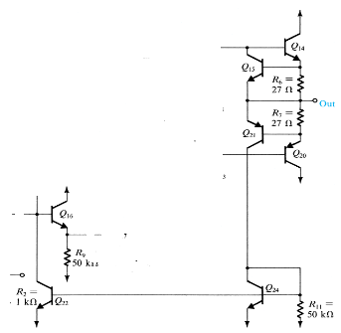

Slide 36
Part-II DC BIASING

Slide 37
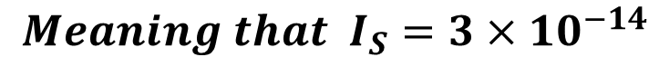
$$Meaning that I_{S}=3×{10}^{−14}$$

Slide 38
Mirror-2
Mirror-1
Widlar current source

Slide 39
: Introduction

Slide 40
: Introduction

Slide 41
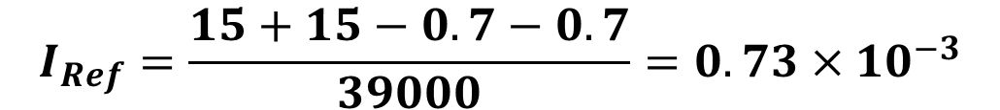

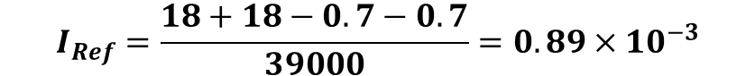
$$I_{Ref}=\frac{15+15−0.7−0.7}{39000}=0.73×{10}^{−3}$$
$$I_{Ref}=\frac{18+18−0.7−0.7}{39000}=0.89×{10}^{−3}$$
$$I_{Ref}=\frac{5+5−0.7−0.7}{39000}=0.22×{10}^{−3}$$

Slide 44
Recall from Chap. 7

Slide 45
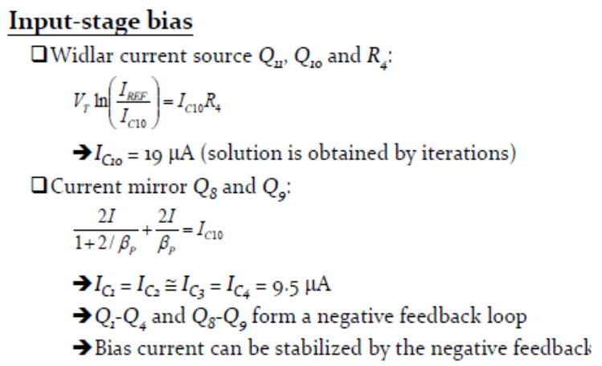
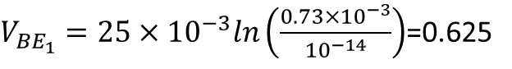
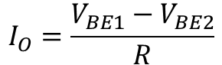
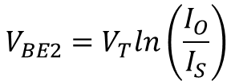
$$I_{REF}=0.73×{10}^{−3} and R_{4}=5KΩ, Assume V_{T}=25×{10}^{−3}$$
$V_{{BE}_{1}}=25×{10}^{−3}ln\left(\frac{0.73×{10}^{−3}}{{10}^{−14}}\right)$=0.625
Assuming $I_{O}$ ten time less we started the iterations
$$V_{BE2}=V_{T}ln\left(\frac{I_{O}}{I_{S}}\right)$$
$$I_{O}=\frac{V_{BE1}−V_{BE2}}{R}$$

Slide 46
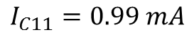
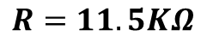
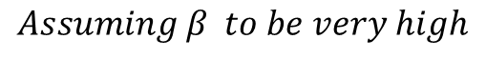
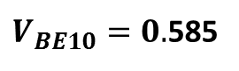
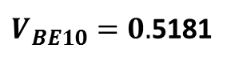
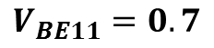
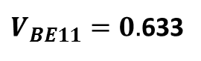
$$Assuming β to be very high$$
$$R=11.5KΩ$$
$$V_{BE11}=0.7$$
$V_{BE10}=0.$585
$$Assuming β=200;as for npn of 741$$
$$I_{C11}=0.99 mA$$
$V_{BE11}=0.$633
$V_{BE10}=0.$5181

Slide 47
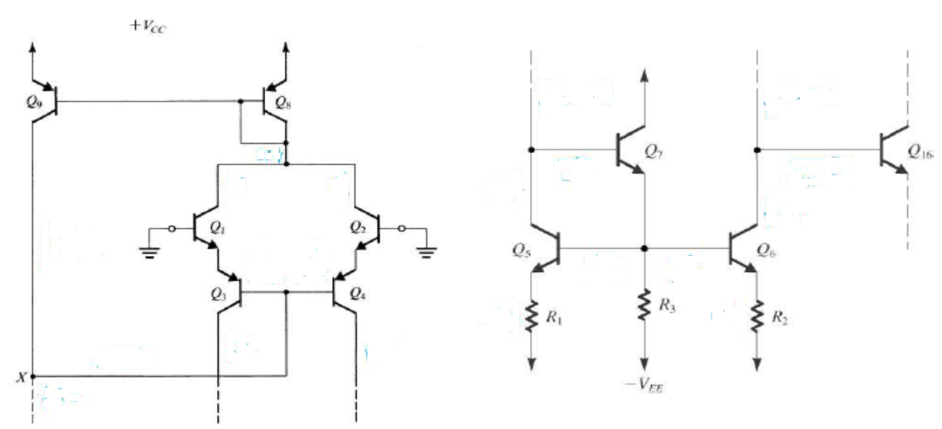

Slide 49
Negative feedback

Slide 51
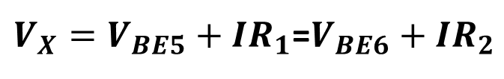
$V_{X}=V_{BE5}+IR_{1}$=$V_{BE6}+IR_{2}$

Slide 52
Second Stage Biasing

Slide 53
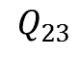
$$Q_{23}$$

Slide 55
Biasing Output Stage

Slide 59
Summary : DC currents

Slide 60
Small Signal Analysis

Slide 61
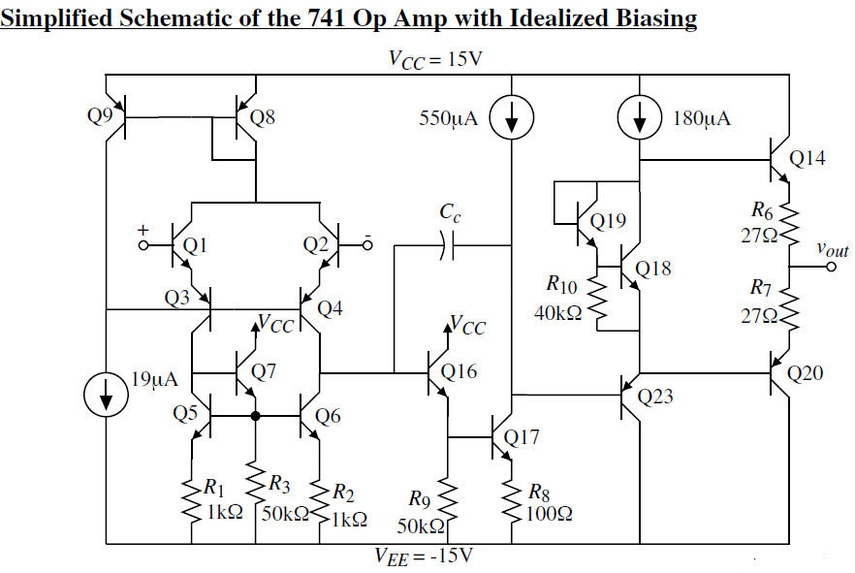
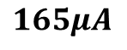
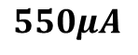
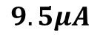
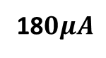
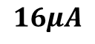
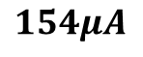
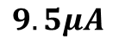
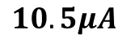
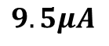
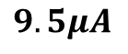
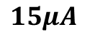
$$9.5μA$$
$$9.5μA$$
$$15μA$$
$$165μA$$
18$0μA$
$$16μA$$
$$9.5μA$$
$$10.5μA$$
$$154μA$$
$$9.5μA$$
$$550μA$$

Slide 65
Input impedance

Slide 67
Transconductance

Slide 69
Output impedance

Slide 70
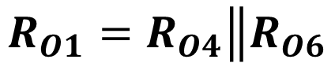
$$R_{O1}=R_{O4}\left\|R_{O6}\right.$$

Slide 71
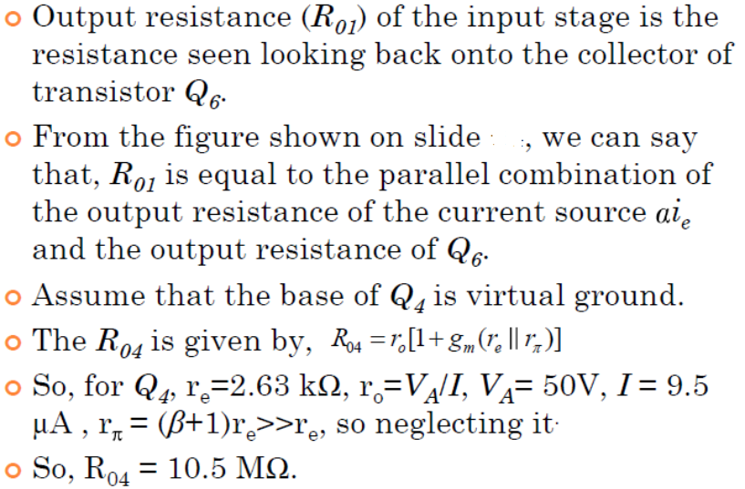
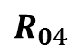
$$R_{04}$$

Slide 72
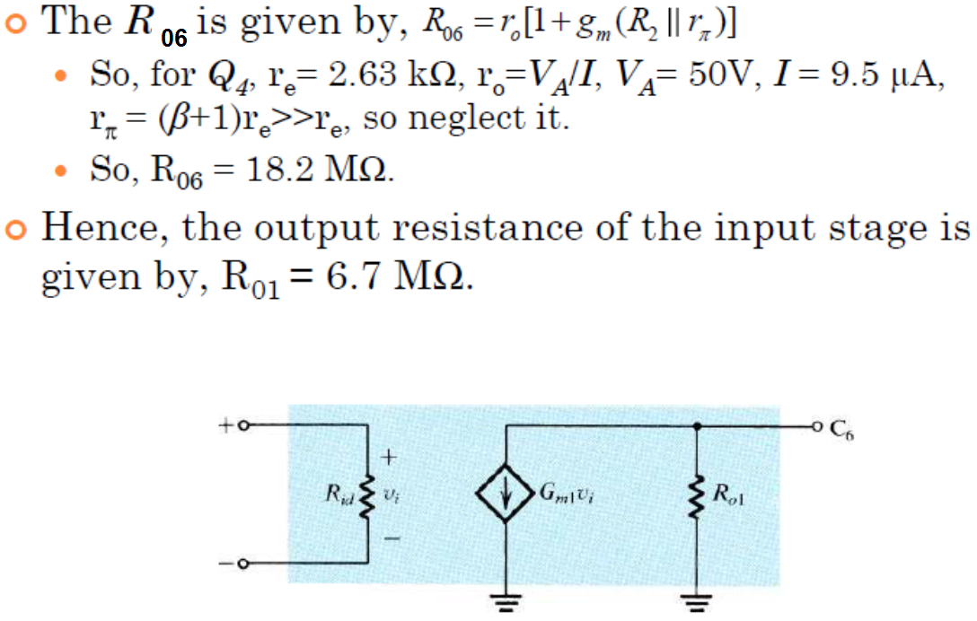

Slide 73
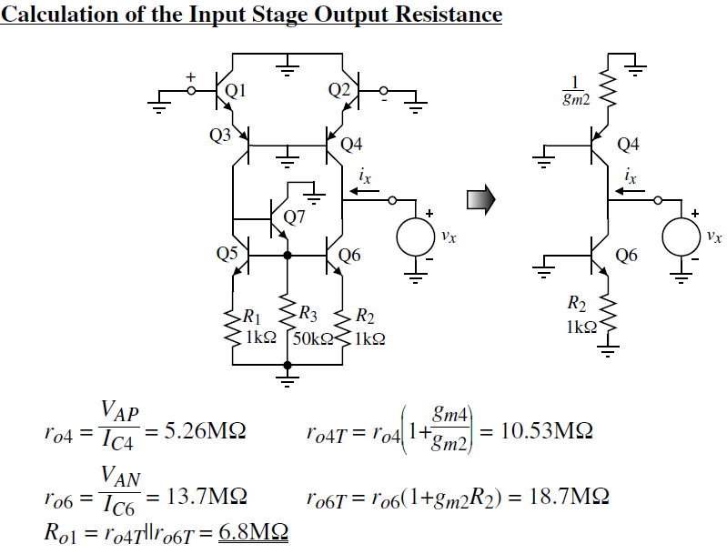

Slide 74
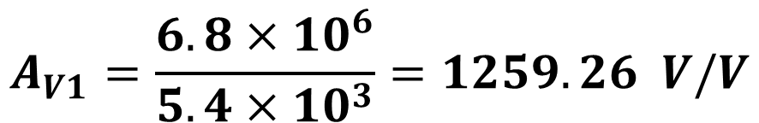
$$A_{V1}=\frac{6.8×{10}^{6}}{5.4×{10}^{3}}=1259.26 V/V$$

Slide 75
Summary of small signal analysis of first stage

Slide 76
Second Stage

Slide 80
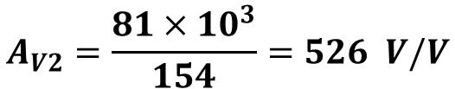
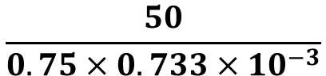
$$\frac{50}{0.75×0.733×{10}^{−3}}$$
$$A_{V2}=\frac{81×{10}^{3}}{154}=526 V/V$$

Slide 81
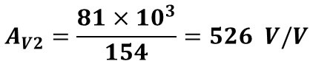
Summary of small signal analysis of second stage
$$A_{V2}=\frac{81×{10}^{3}}{154}=526 V/V$$

Slide 82
Output Stage

Slide 84
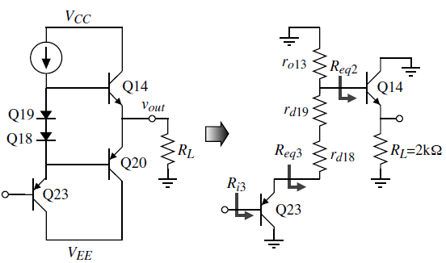
Simplified : Output stage

Slide 86
Output Resistance

Slide 91
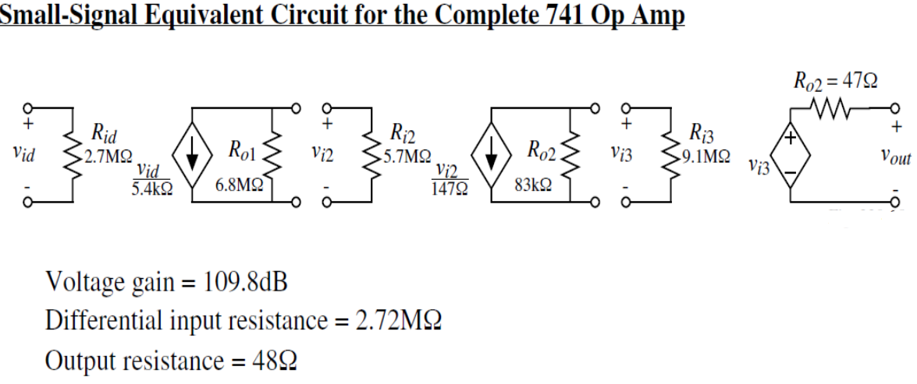

Slide 92
Modern Techniques for the Design of BJT Op. Amps
Although the ingenious techniques employed in the design of the 741 op amp have stood the test of time, they are now more than 50 years old!
Technological advances have resulted in changes in the user requirements of general-purpose bipolar op amps. The resulting more demanding specifications have in turn posed new challenges to analog IC designers who, are responding with new and exciting circuits. In this section
we present a sample of recently developed design techniques.

Slide 93
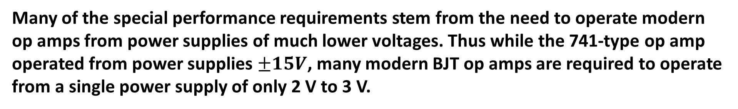
Special Performance Requirements
Many of the special performance requirements stem from the need to operate modern op amps from power supplies of much lower voltages. Thus while the 741-type op amp operated from power supplies $±15V$, many modern BJT op amps are required to operate from a single power supply of only 2 V to 3 V.

Slide 94
Many modern BJT op amps are required to operate from a single power supply of only 2 V to 3 V. This is done for a number of reasons, including the following.
1. Modern small-feature-size IC fabrication technologies require low power-supply voltages.
2. Compatibility must be achieved with other parts of the system that use low-voltage supplies.
3. Power dissipation must be minimized, especially for battery-operated equipment.

Slide 95
There are two important changes:
the use of a single ground-referenced power supply ,
and the low value of power supply.
Both of these requirements give rise to changes in performance specifications and pose new design challenges.
In the following we discuss two of the resulting changes.

Slide 96
Operational amplifiers that use the complete span between negative and positive supply voltage for signal conditioning are generally known as rail-to-rail amplifiers.

Slide 97
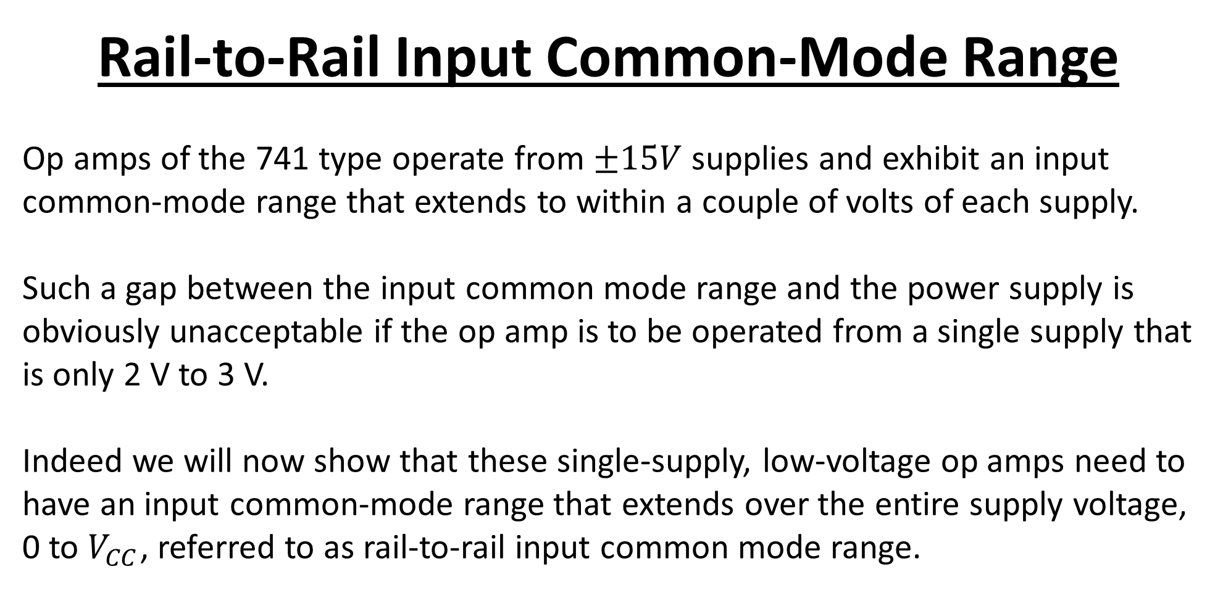
Rail-to-Rail Input Common-Mode Range
Op amps of the 741 type operate from $±15V$supplies and exhibit an input common-mode range that extends to within a couple of volts of each supply.
Such a gap between the input common mode range and the power supply is obviously unacceptable if the op amp is to be operated from a single supply that is only 2 V to 3 V.
Indeed we will now show that these single-supply, low-voltage op amps need to have an input common-mode range that extends over the entire supply voltage, 0 to $V_{CC}$, referred to as rail-to-rail input common mode range.

Slide 98
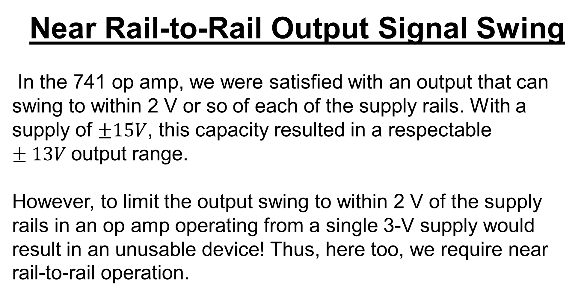
Near Rail-to-Rail Output Signal Swing
In the 741 op amp, we were satisfied with an output that can swing to within 2 V or so of each of the supply rails. With a supply of $±15V$, this capacity resulted in a respectable $±13V$output range.
However, to limit the output swing to within 2 V of the supply rails in an op amp operating from a single 3-V supply would result in an unusable device! Thus, here too, we require near rail-to-rail operation.

Slide 99
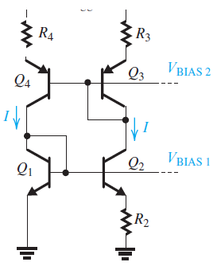

Biasing

Slide 100
Design of the Input Stage to Obtain Rail-to-Rail VICM
For the input common-mode range to include ground voltage, the classical current-mirror-loaded input stage in (a) has to be replaced with the resistively-loaded configuration in (b) with the dc voltage drop across RC limited to 0.2–0.3 V.

Slide 101

Input stage with rail-to-rail input common-mode range and a folded-cascode stage to increase the gain. Note that all the bias voltages including $V_{BIAS 3}$ and $V_{B}$ are generated elsewhere on the chip.

Slide 102

Common-Mode Feedback to Control the dc Voltage at the Output of the Input Stage
An op amp second stage incorporating the common-mode feedback circuit for the input stage. Note that the circuit generates the voltage VB needed to bias the cascode circuit in the first stage. Diode D is a Schottky-barrier diode which exhibits a forward voltage drop of about 0.4V.

Slide 103

Output Stage
A more complete version of the output stage showing the circuits that establish the quiescent current in QP and QN. As well, this circuit forces a minimum current of (IQ/2) to follow in the inactive output transistor, thus preventing the transistor from turning off and minimizing crossover distortion.

Slide 104
Part -v
The Two-Stage CMOS Op Amp

Slide 105
Introduction
The CMOS op-amp are usually designed with a specific application in mind, such as high gain, wide bandwidth, or large output-signal swing.
Many CMOS op amps are utilized within an IC and do not connect to the outside terminals of the chip. As a result, the loads on their outputs are usually limited to small capacitances of at most few picofarads.
Internal CMOS op amps therefore do not need to have low output resistances, and their design rarely incorporates an output stage.
As not connected to outside world there will be no danger of static charge damaging the gate oxide of the input MOSFETs. Hence, internal CMOS op amps do not need input clamping diodes for gate protection and thus do not suffer from the leakage effects of such diodes.
In other words, the advantage of near-infinite input resistance of the MOSFET is fully realized

Slide 106

Visualizing a CMOS operational amplifier
Current source or Active Load
First stage of Amplification
Reference source
Second stage of amplification
$$β$$
Current source or Active Load

Slide 107
The circuit consists of two gain stages: The first stage is formed by the differential pair Q1–Q2 together with its current mirror load Q3–Q4. This differential-amplifier circuit, provides a voltage gain that is typically in the range of 20 V/V to 60 V/V, as well as performing conversion from differential to single-ended form while providing a reasonable common-mode rejection ratio (CMRR).
This simple but elegant circuit has become a classic and is used in a variety of forms in the design of VLSI systems
Lets identify various sections in this circuit

Slide 108
The differential pair is biased by current source Q5, which is one of the two output transistors of the current mirror formed by Q8, Q5, and Q7.

Slide 109
The second gain stage consists of the common-source transistor Q6 and its current-source load Q7. The second stage typically provides a gain of 50 V/V to 80 V/V.

Slide 110
In addition 2nd stage takes part in the process of frequency compensating the op amp. This in turn is achieved by introducing a pole at a relatively low frequency and arranging for it to dominate the frequency-response determination this is implemented using a compensation capacitance CC connected in the negative-feedback path of the second-stage amplifying transistor Q6

Slide 111
12.1.3 Voltage Gain

Slide 113
Recall this from differential Amplifier Chapter

Slide 115
We already Know that

Slide 117
12.1.4 Common-Mode Rejection Ratio (CMRR)

Slide 118
Differential Gain, for CMRR Cal.

Slide 119
Common Mode Gain

Slide 120
12.1.5 Frequency Response
From our study of the stability of feedback amplifiers in Section 10.12.2, we know that the magnitude of the phase margin significantly affects the closed-loop gain. Therefore, obtaining a desired minimum value of phase margin is usually a design requirement.

Slide 122
Simplified Equivalent Circuit
The uniform –20-dB/decade gain roll-off obtained at frequencies f $≫$ fP1 suggests that at these frequencies, the op amp can be represented by the simplified equivalent circuit shown in Fig.
Observe that this attractive simplification is based on the assumption that the gain of the second stage, $A_{2}$, is large, and hence a virtual ground appears at the input terminal of the second stage. The second stage then effectively acts as an integrator that is fed with the output current signal of the first stage; Gm1Vid. Although derived for the CMOS amplifier, this simplified equivalent circuit is general and applies to a variety of two-stage op amps

Slide 123
Phase Margin
The frequency compensation scheme utilized in the two-stage CMOS amplifier is of the pole-splitting type, It provides a dominant low frequency
pole with frequency fP1 and shifts the second pole beyond ft.
Note that at the unity-gain frequency ft, the phase lag exceeds the 90° caused by the dominant pole at fP1. This so-called excess phase shift is due to the second pole

Slide 127
12.1.6 Slew Rate
One common characteristic of an op-amp is the Slew-Rate. It tells how fast the op-amp can charge a capacitor at its output and its a measure of its driving power. That, of course, depends on the value of the capacitive load and its ability to provide current.

Slide 129
Part -II
Folded CMOS Op Amp

Slide 130
12.2 The Folded-Cascode CMOS Op Amp

Slide 134
Summary Of CMOS OP-AMP

Slide 138
Most CMOS op amps are designed to operate as part of a VLSI circuit and thus are required to drive only small capacitive loads. Therefore, most do not have a low-output- resistance stage.
There are basically two approaches to the design of CMOS op amps: a two-stage configuration and a single stage topology utilizing the folded-cascode circuit.
In the two-stage CMOS op amp, approximately equal gains are realized in the two stages.
The threshold mismatch ∆Vt together with the low transconductance of the input stage result in a larger input offset voltage for CMOS op amps than for bipolar units.

Slide 139
Miller compensation is employed in the two-stage CMOS op amp, but a series resistor is required to place the transmission zero at either s = ∞ or on the negative real axis.
􀂄 CMOS op amps have higher slew rates than their bipolar counterparts with comparable f t values.
􀂄 Use of the cascode configuration increases the gain of a CMOS amplifier stage by about two orders of magnitude, thus making possible a single-stage op amp.
􀂄 The dominant pole of the folded-cascode op amp is determined by the total capacitance at the output node, CL.
Increasing CL improves the phase margin at the expense of reducing the bandwidth.

Slide 140
By using two complementary input differential pairs in parallel, the input common-mode range can be extended to equal the entire power-supply voltage, providing so called rail-to-rail operation at the input.
􀂄 The output voltage swing of the folded-cascode op amp can be extended by utilizing a wide-swing current mirror in place of the cascode mirror.

Slide 141

This is how you can develop power supplies for the operational amplifier for your FYPs

Slide 142

Breaking the Loop Example III

Slide 143


Feedback Factor Example III

Slide 144

Breaking the Loop Example IV

Slide 145




Feedback Factor Example IV

Slide 146

Breaking the Loop Example V

Slide 147

Feedback Factor Example V

Slide 148

Breaking the Loop Example VI

Slide 149


Feedback Factor Example VI

Slide 150

Breaking the Loop Example VII

Slide 151

Feedback Factor Example VII

